Slide 1
BioSAXS
Documentation
Alejandro de Maria Antolinos
28/03/2012

Slide 2
Index
List of terms related to samples
List of terms related to data Acquisition
Data processing
Shipping
Use cases
The goal is to determine how the subunits fit together
The goal is to understand how the protein function

Slide 3
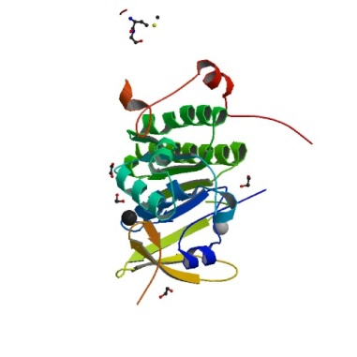
List of terms related to samples
= Macromolecule
A macromolecule is a biological construct
In solution for investigation
A*
ABC
= Complex
A*B*
Description of an assembly containing
multiple macromolecules
Biological assembly
for investigation
A*C*
E*
B*
D*
EBD
Complex ‘Y’
C*
Complex ‘X’
It could be in rare cases more then one assembly the macromolecule belongs to so we should be careful of how to describe
this and or strict with the definition

Slide 4
List of terms related to samples
= Macromolecule: biological construct in solution for investigation
Acronym
Molecular Mass
Number of individual protein chain and residues in each
Number of individual DNA strands and bases in each
Number of individual RNA strands and bases in each
Sequence
Complex (s)
List of regions indicating which part of the complex(s) the macromolecule is
List of possible structures (PDB)
Which part of the macromolecule the structure is
= Complex: Description of an assembly containing multiple macromolecules
Name/Acronym
Molecular Mass
Number of individual protein chain and residues in each
Number of individual DNA strands and bases in each
Number of individual RNA strands and bases in each
Sequence
List of macromolecules

Slide 5
List of terms related to samples
= Buffer: the matched solution in which a sample is suspended
Name/Acronym
Concentration = 0
Temperature
Set Point
Measure for each frame
Type of measurement
Volume to load
pH
Composition
List of additives
= Sample: Specific measurement details for the macromolecule
Macromolecule
Buffer
Concentration > 0
Temperature
Set Point
Measure for each frame
Name: MACROMOLECULE acronym_BUFFER acronym_CONCENTRATION ???
Type of measurement
Volume to load
Comments

Slide 6
List of terms related to samples
= Additive: Any component of the buffer which will be varied in an experiment (salts, ligands, detergents, lipis, deuteration)
Name
Quantity
Type
Buffer
= Structure
A PDB file or accesion code
List of what data this structure is associated with
Complex
Macromolecule

Slide 7
Visual Data Model Draft for Complex
N
N
1
A complex has 1..N macromolecules
A macromolecule has 0..N samples
N
1
A sample has 1 buffer associated
………
1
A buffer has 0..N additives
………
Sample: macromolecule + buffer
complex
macromolecule
Additives

Slide 8
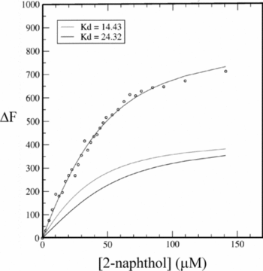
List of terms related to data acquisition
= Frame: One individual exposure of the detector (.edf image and 1D curve .dat)
= Measurement/Run: all frames for an individual acquisition (buffer or individual macromolecular)
= DataCollection: combination of runs (buffer, sample, buffer)
In rare cases it could be (buffer, n*(buffer OR sample), buffer)
Data Collection Group: combined DataCollection for one macromolecule (minimum 3 concentrations). In a collection, by definition all samples are in the same buffer there is only one buffer measurement between samples which is classed as both the buffer_after in the first DC and the buffer_before in the subsequent DC.
DC 1
DC 2
DC 3
DC n
…………………….
Data collection Group for one macromolecule

Slide 9
Case 1: How do the subunits fit together
An enzyme which in its functional form is comprised of 3 individual subunits (A, B and C). The first part of the Experiment ( P1) is to determine how the subunits fit together.
P1 will comprises data collections of:
- A, B and C individually
- The dimeric complexes of AB and BC
- The trimeric complex ABC
Thus the complex will have 6 individual macromolecules associated with it (A, B, C, AB, BC and ABC). Each with a minimum of 3 samples, all with the same buffer conditions
A*
Samples with different concentrations
B*
C*
……………
B1
where n>=3
A*B*
Buffer
A*C*
A*B*C*

Slide 10
Case 1: How do the subunits fit together
Samples with different concentrations
A
…………..
B1
B1
B
B1
…………..
B1
C
…………..
B1
B1
Buffer 1
AB
B_AB
…………..
B_AB
AC
B1
…………..
B1
ABC
B_ABC
…………..
B_ABC
All buffers for the same COMPLEX should have the same conditions ? By default yes BUT they could change

Slide 11
Case 1: How do the subunits fit together
Measurements
A
Samples with different concentration (minimum 3)
B
C
……..
AB
run
AC
By definition is the same buffer
ABC
BUFFER + SAMPLE+ BUFFER
It could be in rare cases BUFFER + ….. + SAMPLE + SAMPLE + …. +BUFFER

Slide 12
Case 1: How do the subunits fit together
Measurements
A
B
C
……..
AB
DC
DC
DC
DC
DC
DC
DC
DC
DC
AC
ABC
Data Collection Grop
DC = DataCollection
Because there is only one buffer the datacollections overlap

Slide 13
Case 1: How do the subunits fit together
Data collected with no optimization
A
……..
Data Collection Group for A
B
……..
Data Collection Group for B
C
……..
Data Collection Group for C
Experiment
AB
……..
Data Collection Group for AB
AC
……..
Data Collection Group for AC
ABC
……..
Data Collection Group for ABC

Slide 14
Case 1: How do the subunits fit together
Time Sequence Measurements
With No optimization
A
AC
B
AB
C
ABC
Problem is that we measure twice the same buffer
With optimization
A
AC
B
C
AB
ABC
Switching buffers with the same conditions in order to put them together
Data Collections are overlapping to avoid the extra buffer measurement
time

Slide 15
Case 1: How do the subunits fit together
Data collected with buffer optimization
A
……..
Data Collection Group for A
B
……..
Data Collection Group for B
C
……..
Data Collection Group for C
Experiment
AC
……..
Data Collection Group for AB
AB
……..
Data Collection Group for AC
ABC
……..
Data Collection Group for ABC
Because buffer for macromolecules A, B and C are the same no an extra buffer measurement is necessary between their data collections when measured sequentially

Slide 16
Case 2: How does the enzyme function
P2 will comprises data collections of:
The trimeric complex ABC (same conditions as for P1)
Plus a data collection for each buffer condition (Ligands and additives required for activity and /or non hydrolysable homologues to isolate the various stages of the reaction).
Thus the macromolecule ABC will have an additional n*3 samples where n is the number of buffer conditions that need to be measured.
A
B
No measurements
Samples
C
AB
AC
ABC
B1
B2
……………
Buffers Conditions c1
Buffers Conditions c2
ABC_B1_10_4C
ABC_B1_30_4C
ABC_B1_50_4C
ABC_B2_10_10C
ABC_B2_30_10C
ABC_B2_50_10C

Slide 17
Case 2: How does the enzyme function
Measurements
A
B
C
AB
AC
Buffer conditions 1
Buffer conditions 2
Buffer conditions 3
ABC
…..

Slide 18
Visual Data Model Draft for Data Collection
….
….
Run
DataCollection
Frame
….
………
….
….
….
Data Collection Group
Data Collection
Run
Frame

